Slide 1
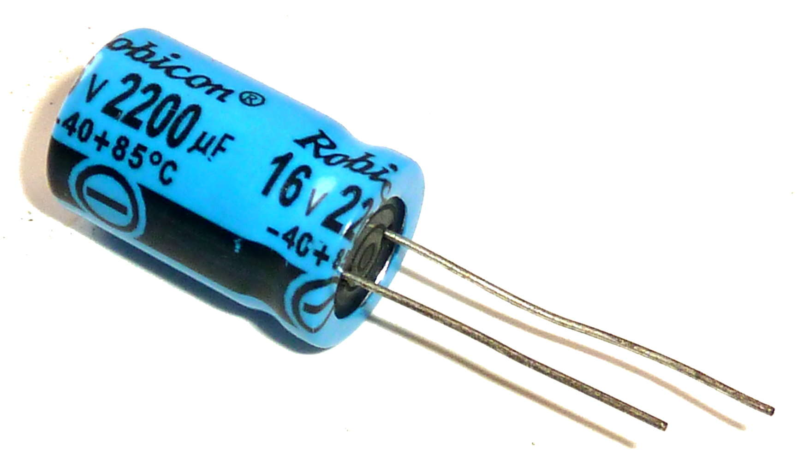
ELECTRONICS 101
Capacitor

Slide 2

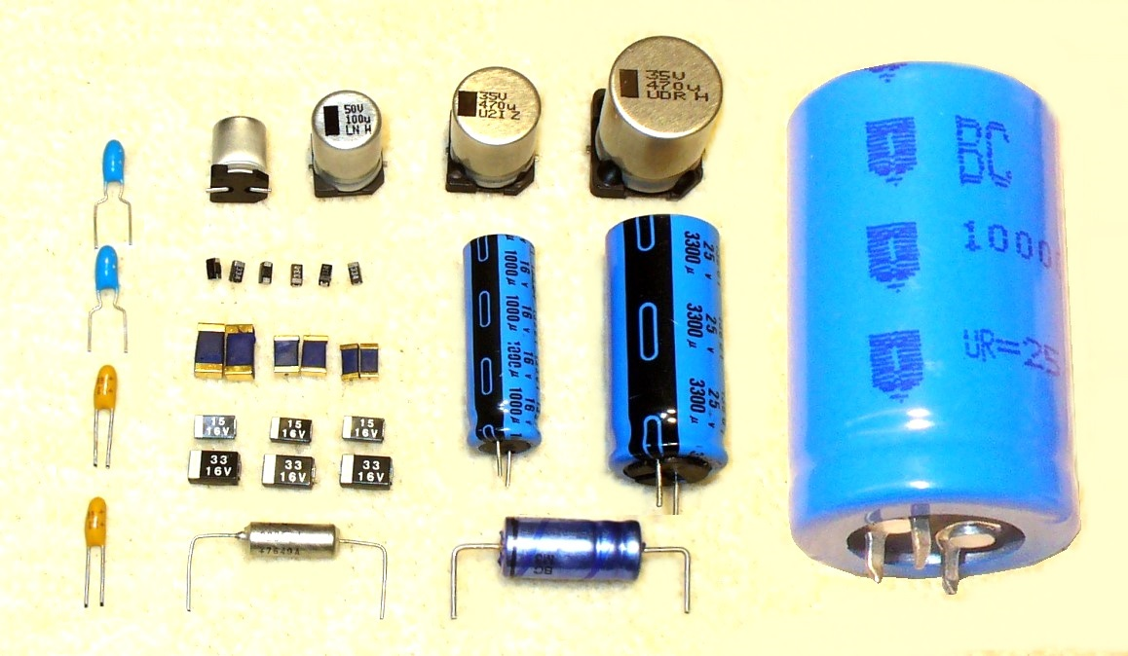
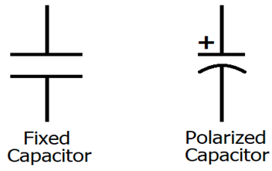
What is a Capacitor?
A component that stores charge
Very useful for mostly AC circuits
There are different kinds of Capacitor
Measured in Farad (F)
Most (if not all) have dipole material
Discharge when the device shuts off or circuit is broken
Symbol for Capacitor

Slide 3
Capacitance Equation(s)
C = Q/V
Where:
C – capacitance
Q – Charge (1.6 x 10^-19 C)
V – Voltage
C = (ε * A)/d
Where:
ε – Permittivity (for free space or air - 0.0088 nF/m)
A – Surface area of the plate
d – distance between the two plates

Slide 4
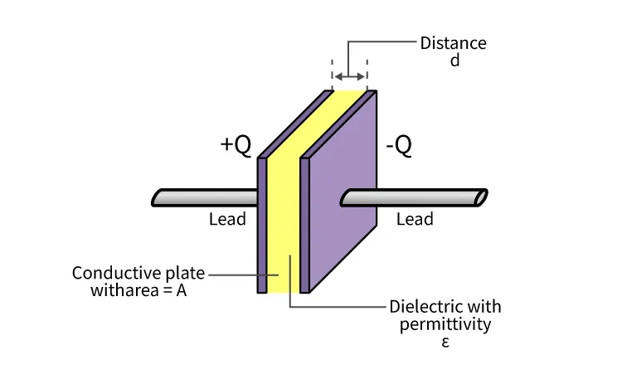
Anatomy of Capacitor

Slide 5
How Capacitor works?
When the Capacitor is fully charged, the current stops flowing towards the capacitor
If the circuit is disconnected and the capacitor is fully charged and wired in parallel towards other components (e.g. resistors, LEDs), the amount of charge stored in the capacitor gets discharged towards that component
In other words, capacitor acts like a makeshift battery

Slide 6
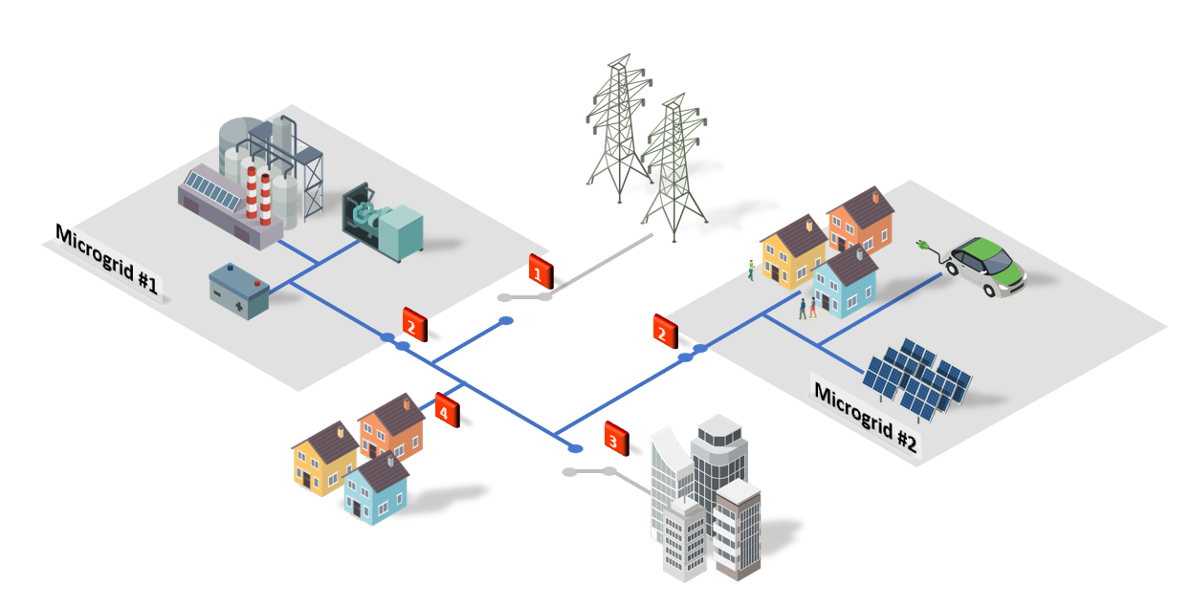
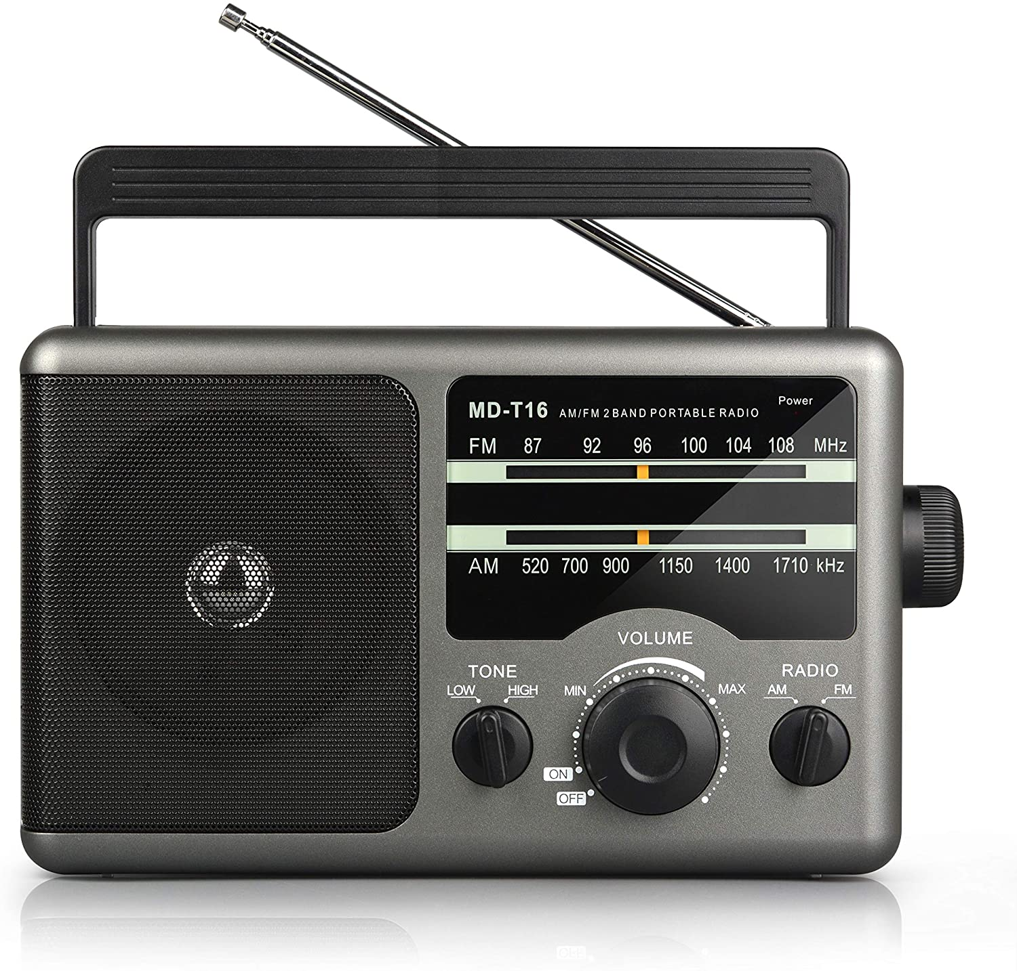
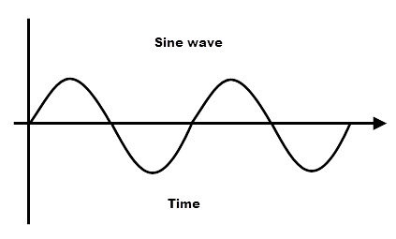
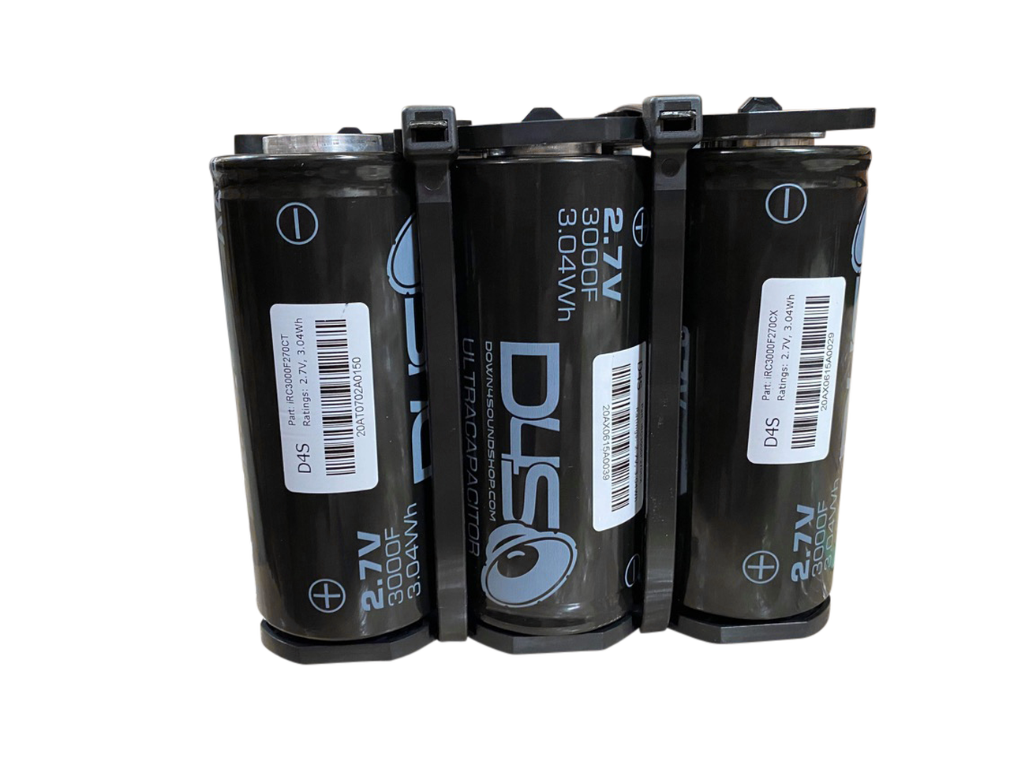
Capacitor Uses
Instance where you need to filter out noise and certain frequencies
Radios (variable capacitor)
Super Capacitor
Infrastructure
Microgrid
Generate Waveform
Sine Wave

